Slide 1
Salary Prediction
Internship
Mentorness
Task-2 Batch Name: MIP-ML-14
By
Prashant

Slide 2
This is a regression problem
TO BUILD THIS MODEL I HAVE PERFORMED THREE MAIN STEPS
First step
Data preprocessing and feature engineering
Second step
Creating the Pipeline and Training of the Model
Third step
Deploy this model on the web page and predict the salary

Slide 3
Step-1
Read data set using pandas read_csv function.
Perform data preprocessing steps
1. Check null values
Total 13 entries are null
Remove all null values
2. Check for duplicated rows
A total of 161 rows are duplicated
Remove all of them.

Slide 4
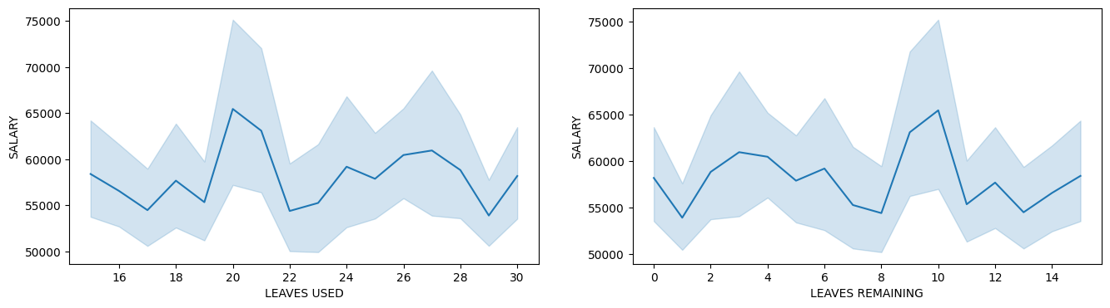
The column in the salary dataset:
['FIRST NAME', 'LAST NAME', 'SEX', 'DOJ', 'CURRENT DATE', 'DESIGNATION', 'AGE', 'SALARY', 'UNIT', 'LEAVES USED', 'LEAVES REMAINING', 'RATINGS', 'PAST EXP’]
→Drop : FIRST NAME, LAST NAME

Slide 5
So, also drop ‘LEAVES USED’, ‘LEAVES REMAINING’
Exploratory data analysis
Salary is linearly correlated with ‘AGE’ and ‘PAST EXP’
Outlier detection and removal
The ‘AGE’, ‘PAST EXP’, and ‘SALARY’ columns have outliers
Remove outliers using the IQR method: BoxPlot
Feature Engineering
Feature Extraction: ‘DOJ’ and ‘CURRENT DATE’ indicate the individual’s joining
time in the company
So, extract a new feature ‘WORKING YEARS’ and drop ‘DOJ’ and ‘CURRENT DATE’

Slide 6

Step-2
Now data set has :['SEX', 'DESIGNATION', 'AGE', 'SALARY', 'UNIT’, 'RATINGS', 'PAST EXP’]
Only seven columns
Apply train_test_split
Import required libraries
from sklearn.model_selection import train_test_split
from sklearn.compose import ColumnTransformer
from sklearn.preprocessing import OneHotEncoder
from sklearn.preprocessing import OrdinalEncoder
from sklearn.preprocessing import StandardScaler
from sklearn.linear_model import LinearRegression
from sklearn.tree import DecisionTreeRegressor
from sklearn.ensemble import RandomForestRegressor
from sklearn.ensemble import GradientBoostingRegressor
from sklearn.pipeline import Pipeline

Slide 7
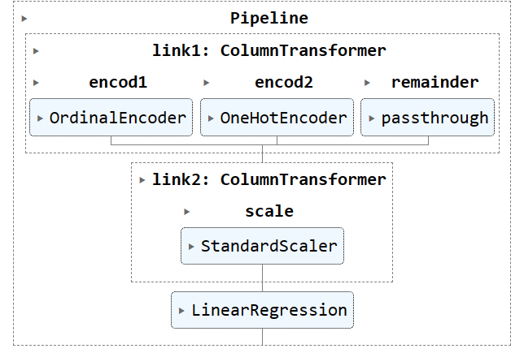
Steps for pipeline

Slide 8
Creating pipeline
pipe=Pipeline([('link1',link1),('link2',link2),('link3',link3)])
Train this ‘pipe’ object
pipe.fit(X_train,y_train)
Check the performance of the model
ypred=pipe.predict(X_test)
r2_score(ypred,y_test)
r2_score=0.950405401207292: This indicates that the model explains approximately 95.04% of the variance in the target variable. A higher r2_score generally suggests a better fit.
r2_score=0.8629712851111709 This indicates that the model explains approximately 86.30% of the variance in the target variable.
r2_score of linear regression is highest, Hence this model is used for prediction.

Slide 9
Pickle this model
import pickle
pickle.dump(pipe,open('salary.pkl','wb’))

Slide 10
Step-3
Deploy this model on a webpage
For this
I have used a Python web framework
Flask
Come to the web page, Enter input and
see predicted

Slide 11

Thank you

